Slide 1


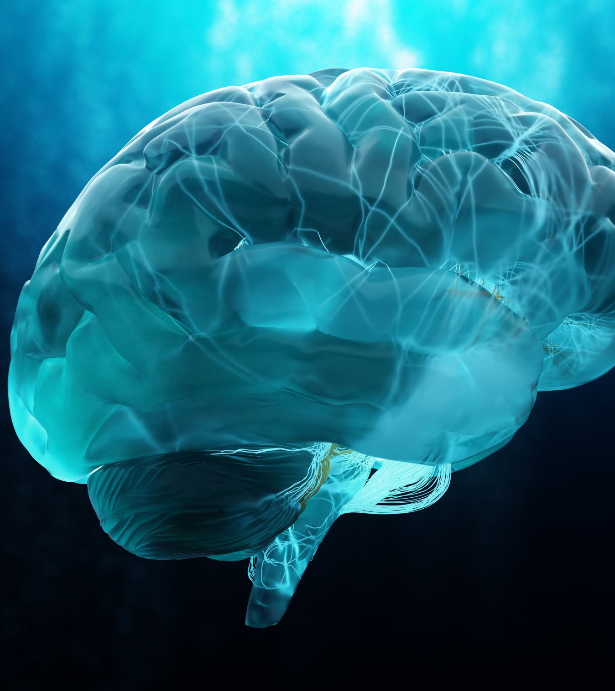
Mental health posts classification
Using deep learning

Slide 2
Group member information
SRAVANI LANKALA 700746285
MANISHA LAKKARSU 700746573
ROHILA POTLURI 700744509
VAISHNAVI KATAKAM 700743493

Slide 3
Roles and responsibilities
Name | Role | Responsibility
Rohila Potluri | Project Lead | Developing project's flow, project timelines and deliverables. Coordinating team members
Sravani Lankala | Data Collection and Preprocessing | Collect subreddit posts data post-COVID-19 (2018-2020). Clean and preprocess data for analysis.

Slide 4
Roles and responsibilities
Name | Role | Responsibility
Vaishnavi Katakam | Model Development and Implementation | Develop the LSTM model for text analysis.
Manisha Lakkarsu | Comparative Analysis and Insights | Conduct comparative analysis on explicit and non-explicit data.

Slide 5
Motivation
The motivation behind this work is firstly, to understand how individuals articulate their mental health struggles in online platforms, thereby providing valuable insights. Secondly, the development of an effective classification model for identifying mental health issues. Leveraging deep learning techniques, specifically Long Short-Term Memory (LSTM) networks. LSTMs are specifically designed to overcome the limitations of traditional neural networks when processing sequential data, making them exceptionally well-suited for analyzing the dynamic and context-dependent nature of language within these posts

Slide 6
Objectives
The primary objective of the project is to develop an effective LSTM-based classification model to classify mental health issues.
The main goal of this project is to use deep learning techniques to classify the posts and overcome the challenges of traditional machine learning models.
Analyzing online posts of mental health issues: This objective is the cornerstone of the project. We analyze the posts and draw observations on how people express their struggle on online platforms.
Analyzing temporal nature of the text: This objective addresses the temporal nature of the text that is sequential patterns in the data.
Adaptability to varied lengths of text: This objective focuses on model compatibility to varied length of texts in real time.
The final objective is to translate all these observations into practical solutions

Slide 7
Related work
This study aimed to understand mental health awareness in the Malaysian community using data from NGO Twitter accounts. Employing sentiment analysis and machine learning techniques (NN, SVM, NB), the results indicated that positive tweets were predominant. The findings suggest that promoting positivity in tweets could enhance mental health awareness [1].

Slide 8
Related work
The study addresses the challenge of mental health in today's modern world, considering traditional factors like family pressure, unemployment, homesickness, and unhappy relationships as common triggers for mental illness. The study conducts a comparative analysis of Conv-LSTM and BERT models. The study proposes a user-friendly, deep learning-based chatbot framework. The proposed framework includes a module to track social media activity, a chat module for real-time conversations and a deep learning-based mental illness detection[2].

Slide 9
Related work
The proposed approach involves employing NLP BERT with a deep neural network to analyze social media conversations over time. The primary goal is to assist the Omani Ministry of Health in delivering comprehensive mental health care services. The dataset is evaluated for emotional behaviors, specifically focusing on identifying signs of depression. The system not only urges users to priorities mental health but also informs the mental health sector about individuals' mental health status.

Slide 10
Problem statement
Mental health remains a pressing global concern, with approximately 970 million individuals affected by mental disorders worldwide, particularly anxiety and depressive disorders. Despite the alarming rise in mental health issues during the COVID-19 pandemic, effectively identifying and classifying mental health-related posts poses a significant challenge. The current system lacks an automated and efficient system for timely recognition and categorization of mental health indicators within online discussions.

Slide 11
Proposed solution
In addressing the challenge of accurately classifying mental health-related posts, our proposed solution focuses on using Long Short-Term Memory (LSTM) networks to categorize posts related to mental health. Unlike traditional neural networks, LSTMs are well-suited for capturing and understanding patterns within sequences, making them particularly effective for analyzing mental health posts.

Slide 12
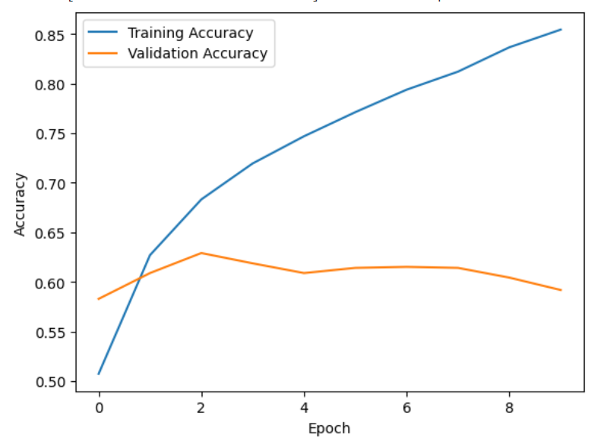
Results
Figure 1 represents the accuracy of data with explicit words this model is also trained for 10 epochs.
At the end of 10 epochs, the model achieved 85
percent training accuracy and 60 percent validation accuracy.
fig.1.Accuracy plot for unfiltered data

Slide 13
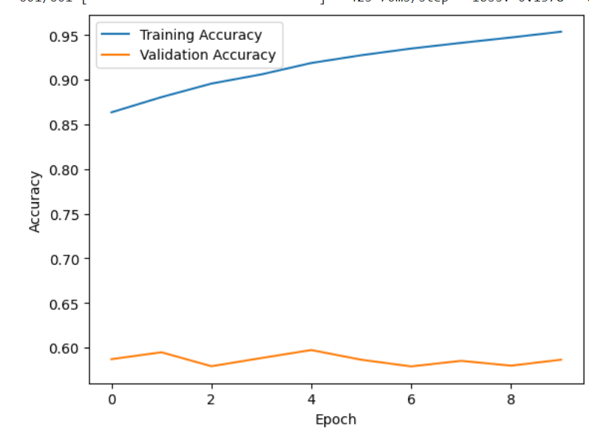
Results
Figure 2 represents the accuracy of the without explicit words data.
At the end of 10 epochs, the model achieved 95 percent training accuracy and 58 percent validation accuracy.
fig.2.Accuracy plot for filtered data

Slide 14
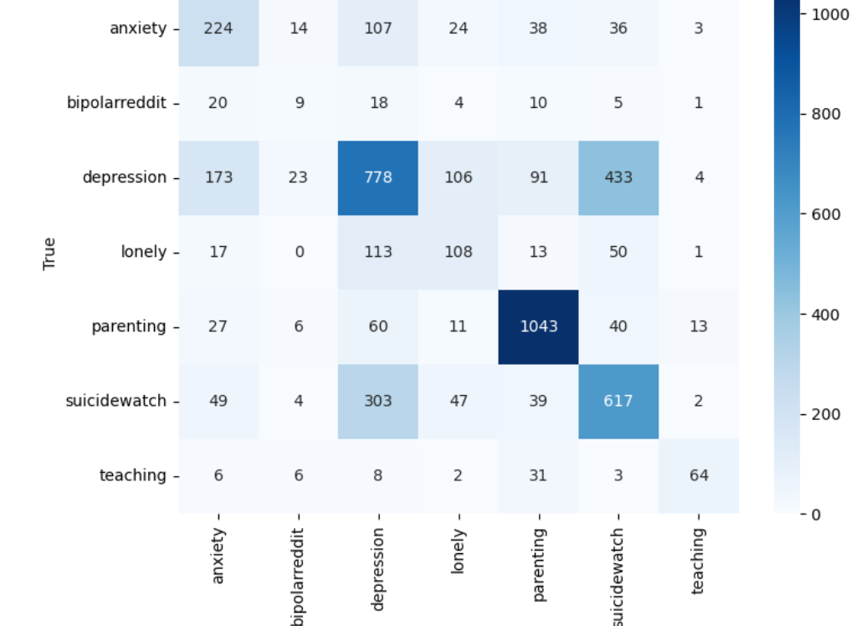
Results
Figure 3 represents the confusion matrix.
The analysis reveals the model’s strong performance in classifying non-mental disorder posts related to parenting.
However, challenges persist in accurately categorizing posts related to depression, suicide watch, and anxiety, leading to misclassifications in these mental health categories.
Fig.3. Confusion matrix for unfiltered data

Slide 15
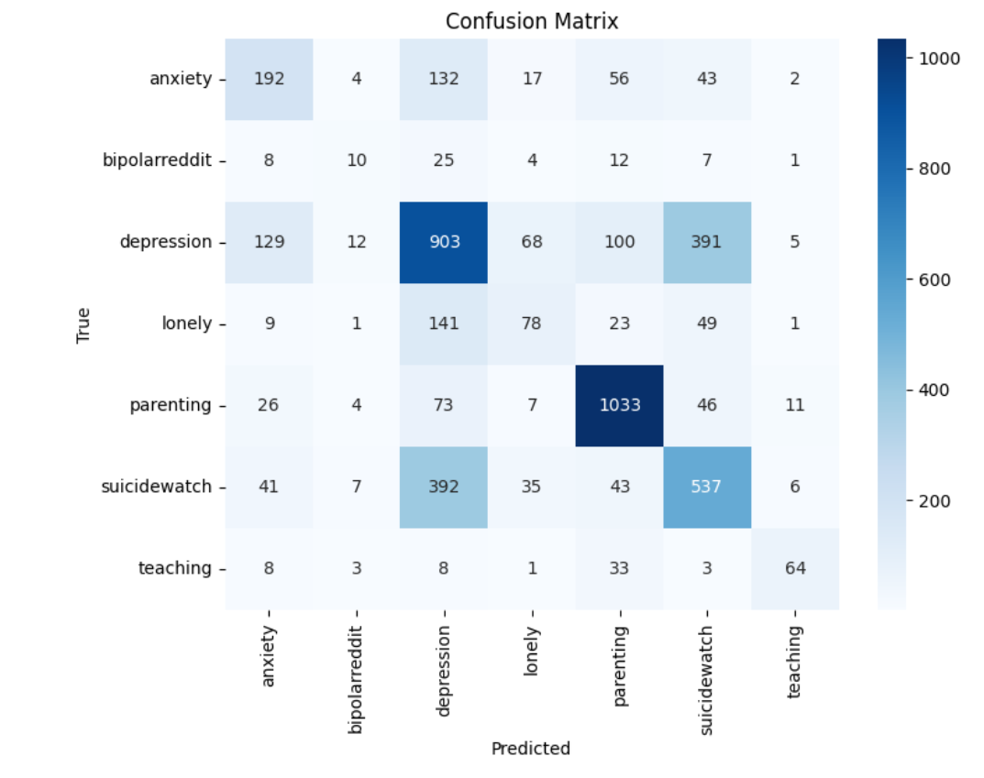
Results
Figure 4 represents the confusion matrix.
It states that the model excels in accurately identifying posts about parenting, but faces challenges in distinguishing between posts related to depression and suicide watch, as well as occasionally misclassifying anxiety posts as depression
Fig.4. Confusion matrix for filtered data

Slide 16
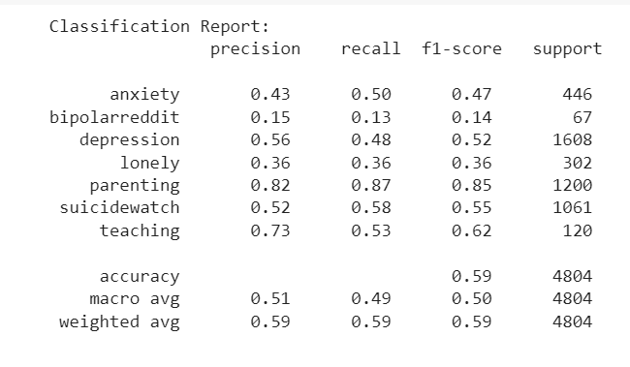
Results
Figure 5 represents classification report.
The model excels in precision for the ”Parenting”
category, indicating a high proportion of correctly identified parenting posts among those predicted as such.
Conversely, the precision for the ”Bipolar” category is relatively lower, suggesting a higher likelihood of misclassifying posts as bipolar among those predicted.
The results of classification report of unfiltered data shows the same results.
Fig.5. Classification report for filtered data

Slide 17
References
[1].R. A. Rahman, F. Haziqah Mohamad Zaini, M. S. Nizam Mohd Danuri and A. Amin, "The Sentiment Analysis on Mental Health Awareness by Non-Governmental Organisation's Twitter," 2022 International Visualization, Informatics and Technology Conference (IVIT), Kuala Lumpur, Malaysia, 2022, pp. 185-190, doi: 10.1109/IVIT55443.2022.10033345.
[2].S. Abu Noman Siddik, B. M. Arifuzzaman and A. Kalam, "Psyche Conversa - A Deep Learning Based Chatbot Framework to Detect Mental Health State," 2022 10th International Conference on Information and Communication Technology (ICoICT), Bandung, Indonesia, 2022, pp. 146-151, doi: 10.1109/ICoICT55009.2022.9914844.

Slide 18
References
[3].B. K. AlSaidi, S. K. AlMamari and F. Hajamohideen, "A survey on mental health based on NLP," 6th Smart Cities Symposium (SCS 2022), Hybrid Conference, Bahrain, 2022, pp. 210-215, doi: 10.1049/icp.2023.0406.

Slide 19
THANK YOU

